Slide 1
Control Design of 3 DOF Robot
Guided by Dr. Rahul Sharma
Priyadarshini (110119040)
Rishivanthiya (110119092)
Sudhindra (110119039)

Slide 2
Work Done

Slide 3
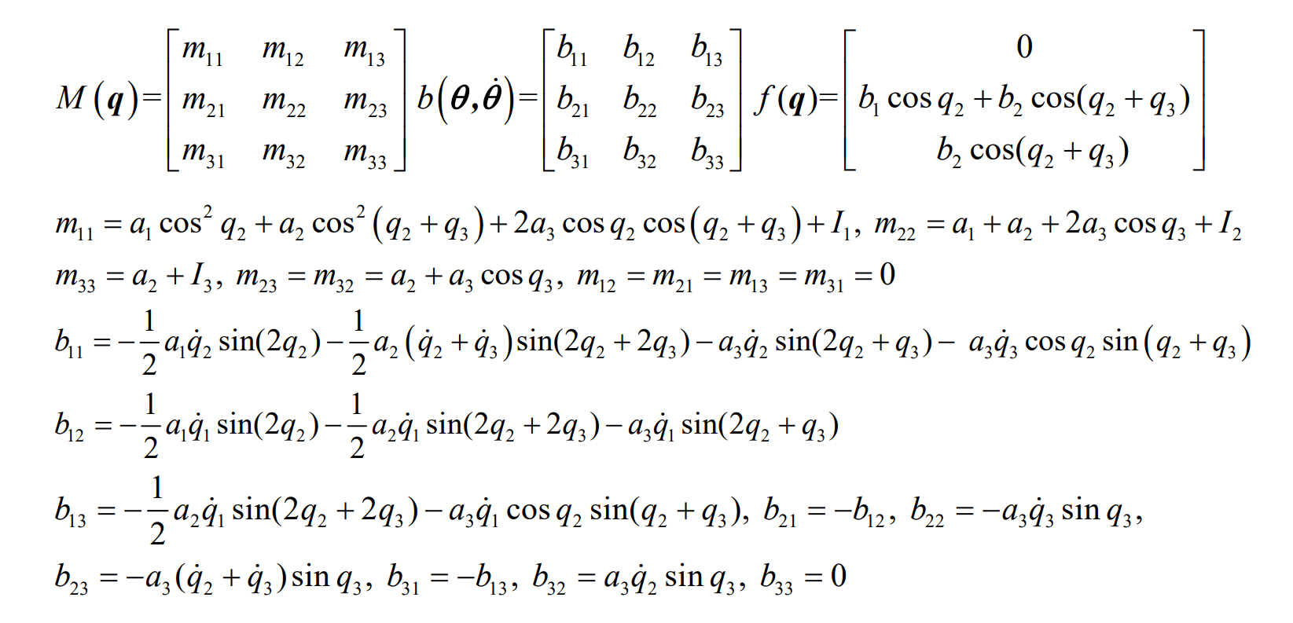
Dyanmic Equation: Defines the relationship between joint position q, angular velocity ˙q, and angular acceleration ¨q to torque τ necessary to achieve desired position, velocity, and acceleration

Slide 4
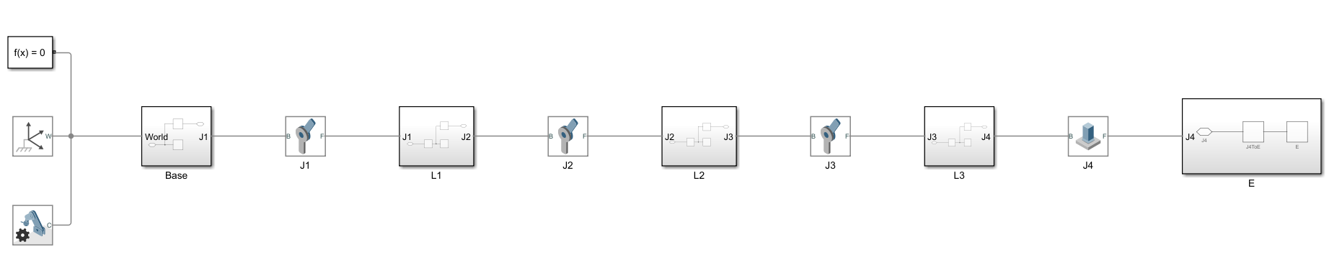
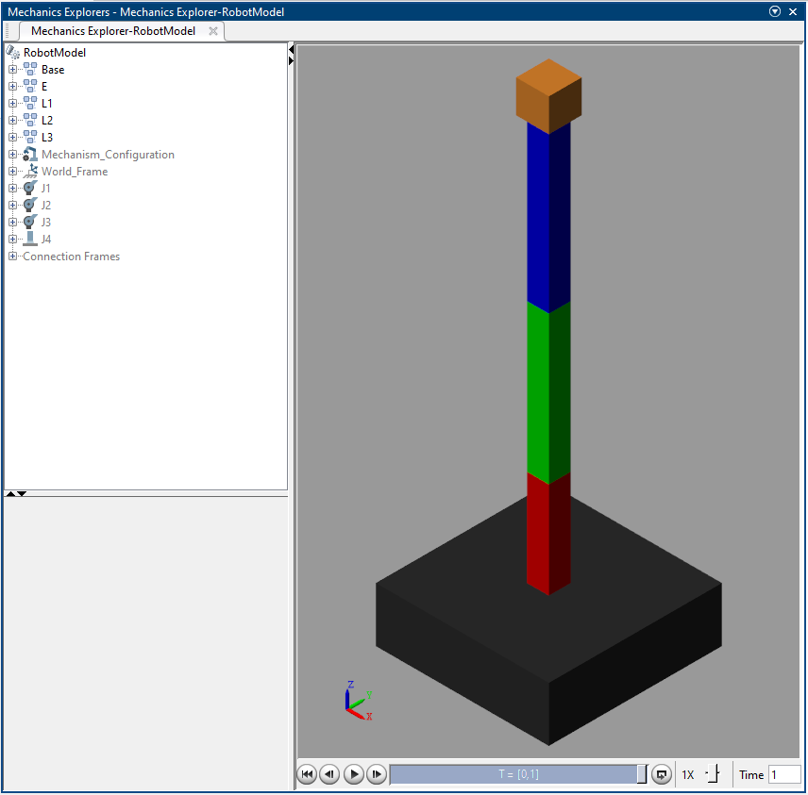
Modeling the Robot in SimScape

Slide 5
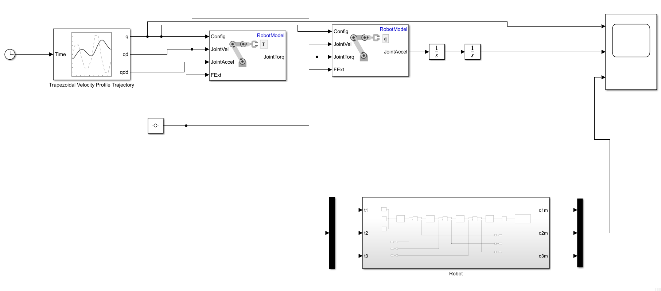
Driving the Robot through Dynamics

Slide 6
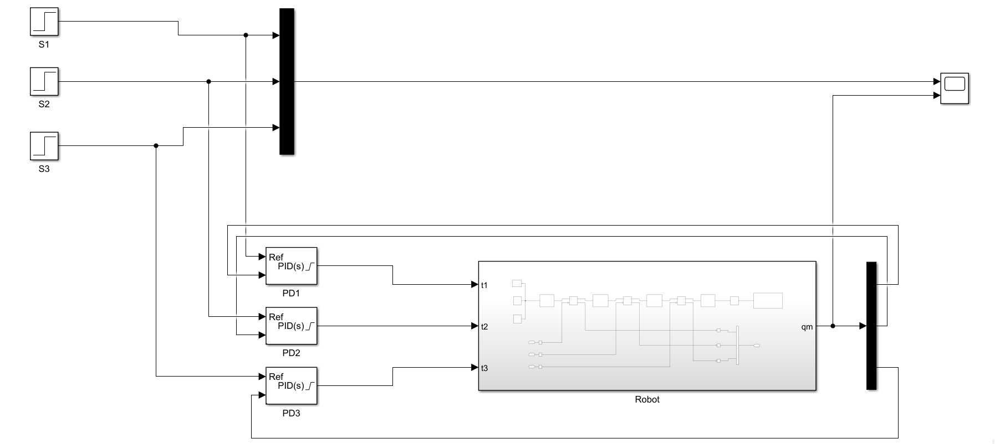
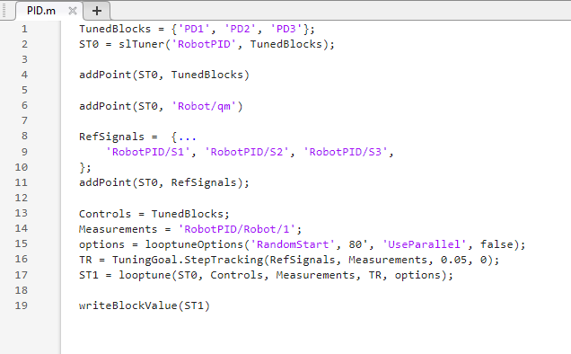
PID with step input and slTuner

Slide 7
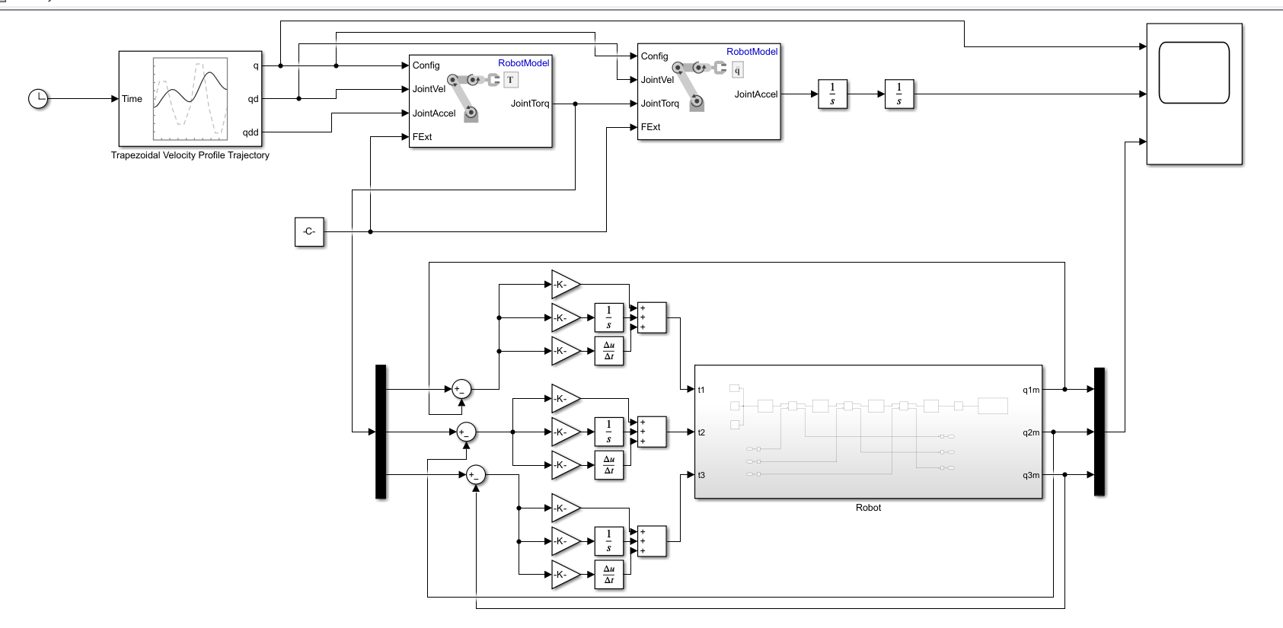
Implementing the PID in the robot

Slide 8
Results

Slide 9
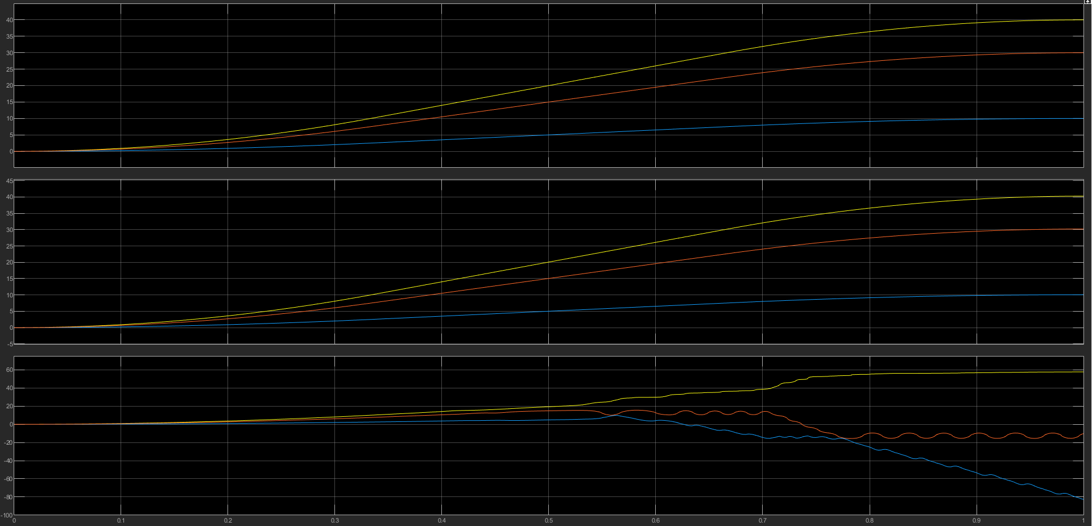
Robot Dynamics Result

Slide 10
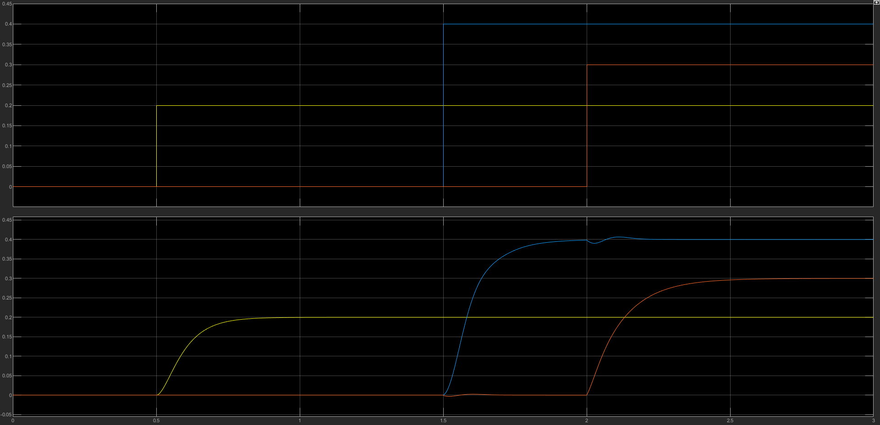
PID with step input Result

Slide 11
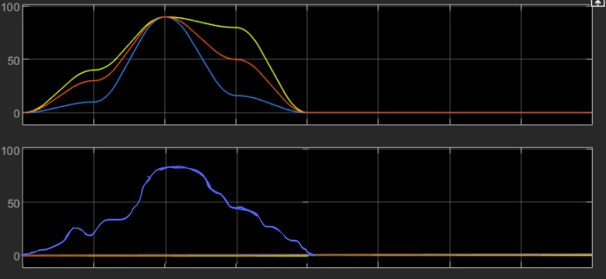
PID Controller Result:

Slide 12
Individual Contributions
Priyadarshini (110119040)
Forward and Inverse Kinematics.
Rishivanthiya (110119092)
Mathematical modelling of Robot.
Implementing the PID controller.
Tuning the controller
Sudhindra (110119039)
Dynamic Equation
Modeling of Robot in SimScape
Driving the Robot through Dynamics
PID with step input and slTuner

